Slide 1
FRIENDS project
Nauruzbayeva Farikha (nerray nero)
Serikbay Arailym (udontnoume)
Sabyr Akbilek

Slide 2
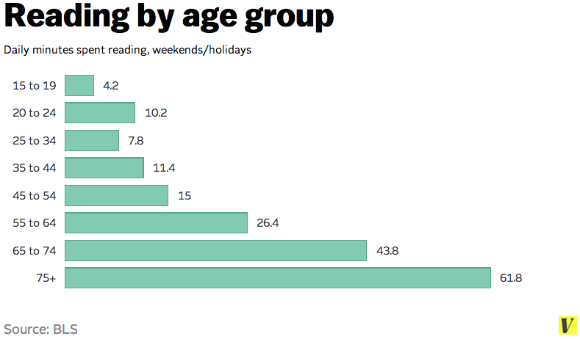
Project description and data preparation
Library management system
Books database
Book recommendation
PHP/MYSQL

Slide 3
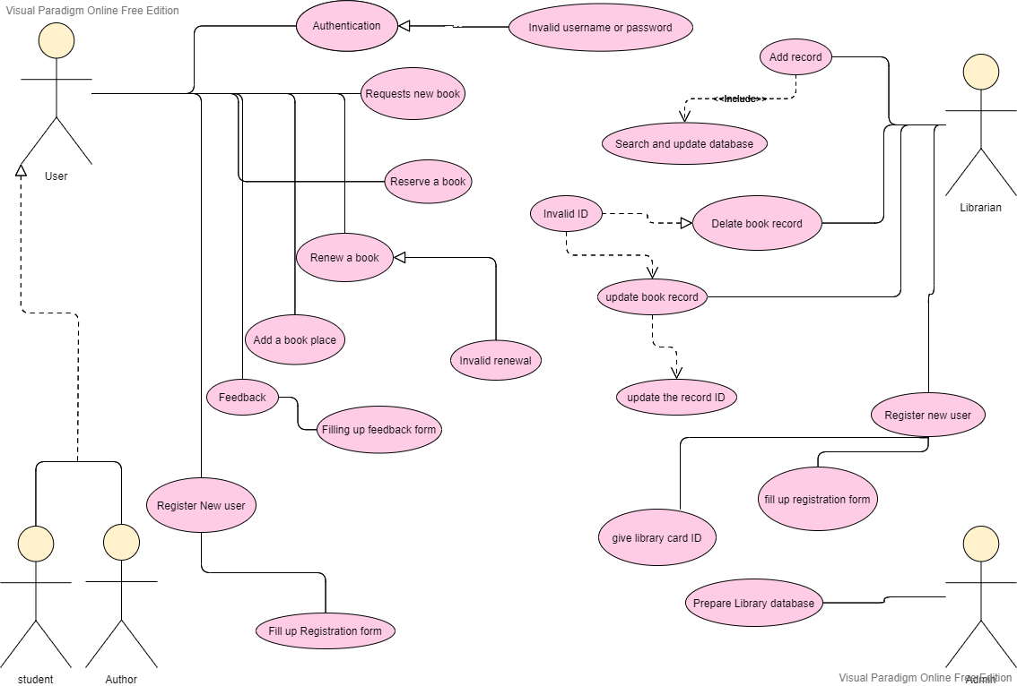
UseCase diagram

Slide 4
Table structure
Books
BOOKID
PUBLISHER
YEAR_OF_PUB
BOOK_TITLE
AVAILABILITY
User
USER_ID
USER_NAME
USER_TYPE
EMAIL
PHONE_NUMBER
PASSWORD

Slide 5
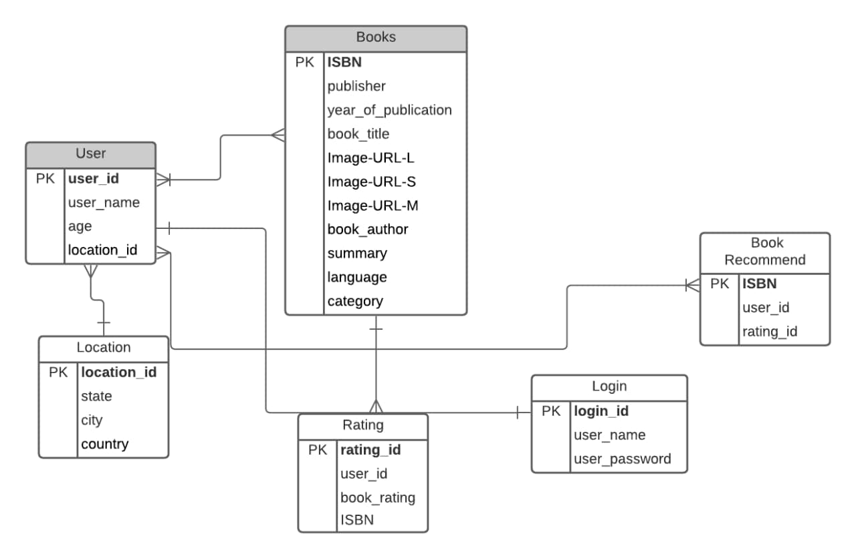
DDL QUERIES
DML QUERIES

Slide 6
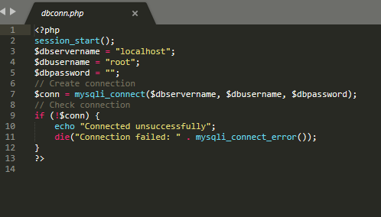
DATABASE CONNECTION

Slide 7
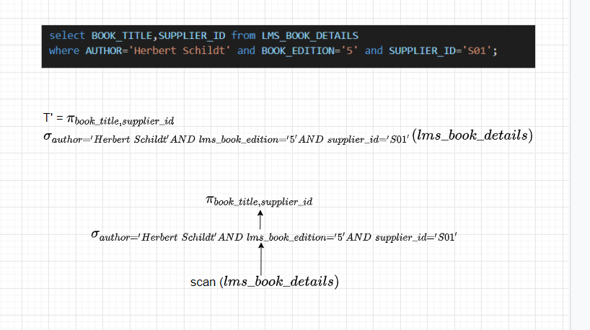
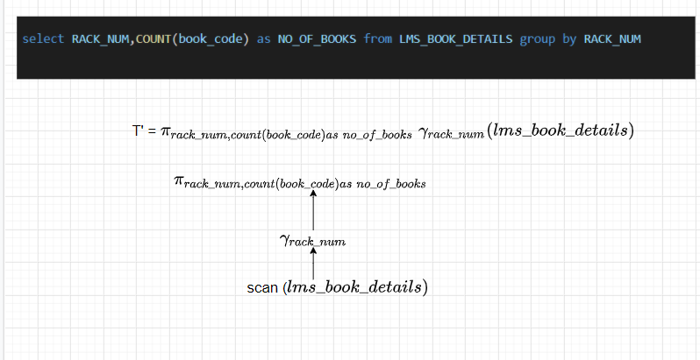
SQL TO RELATIONAL EXPRESSIONS

Slide 8
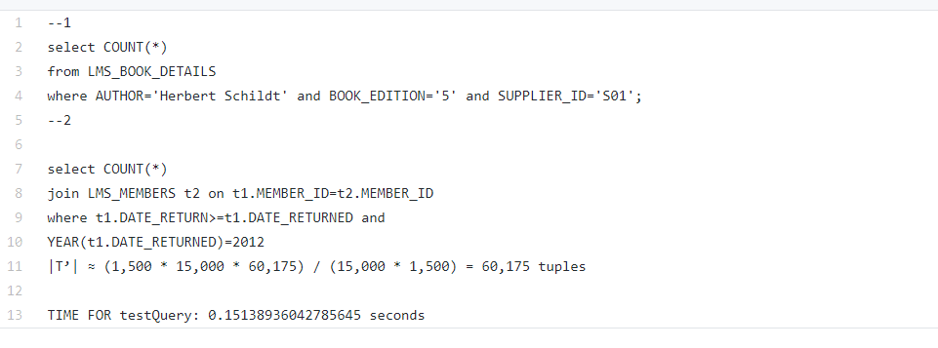
CALCULATION OF TRUE CARDINALITIES

Slide 9
DEMONSTRATING WEBSITE

Slide 10
THANKS FOR ATTENTION
Nauruzbayeva Farikha (nerray nero)
Serikbay Arailym (udontnoume)
Sabyr Akbilek

